Slide 1
MULTITASKING
Multitasking allows several activities to occur concurrently on the computer.
Two types are :
  Process-based multitasking : allows different processes(i.e. programs) to run concurrently.
  Thread-based multitasking : allows different parts of the same program to run concurrently.

Slide 2
COMPARISION
Process-based Multitasking
A process is a program that is executing.
A program is the smallest unit of dispatchable code.
Processes are Heavyweight
Each process requires its own separate address space.
Interprocess communication is expensive and limited.
Context switching from one process to another is costly.
Thread-based Multitasking
A thread is a path of execution within a program, that is executed separately.
A thread is the smallest unit of dispatchable code.
Threads are Lightweight.
Threads share the same address space and cooperatively share the same process.
Interthread communication is inexpensive
Context switching from one thread to the next is at low cost.

Slide 3
The Main thread
Main thread starts executing when your java program begins.
It is important for two reasons :
  It is the thread from which other “child” threads spawn.
  Often it must be the last thread to finish execution because it performs various shutdown actions.
Although, it is created automatically when your program starts, it can be controlled through a Thread object.
To do so, a reference to the Thread object is obtained by calling the currentThread( ) method which is a public static member of the Thread.

Slide 4
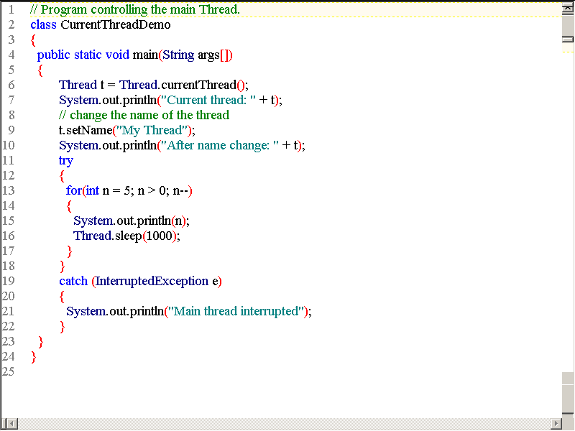

Slide 5
Output:
Current thread: Thread[main,5,main]
After name change: Thread[My Thread,5,main]
5
4
3
2
1
Press any key to continue . . .

Slide 6
The output displays in order the
Name of the thread- main, My Thread
Priority- 5
Thread Group – main, main

Slide 7
LIFE CYCLE OF A THREAD
Life cycle of a thread consists of following states :
Newborn state
Runnable state
Running state
Blocked state
Dead state
A thread is always in one of these five states.
It can move from one state to another via a variety of ways as shown in figure.

Slide 8
State Transition Diagram of a thread
Newborn
New Thread
start
stop
Killed Thread
Active Thread
Running
Runnable
stop
Dead
yield
stop
(suspend, sleep, wait)
(resume, notify)
Idle Thread (Not Runnable)
Blocked

Slide 9
Newborn State
When we create a thread object, the thread is born and said to be in newborn state.
The thread is not yet scheduled for running.
At this state we can do only one of the following things with it :
  Schedule it for running using start( ) method.
  Kill it using stop( ) method.
If scheduled, it moves to the runnable state(as shown is fig.).
If we attempt to use any other method at this stage, an exception will be thrown.

Slide 10
Scheduling a newborn thread
Newborn
stop
start
Runnable
Dead

Slide 11
Runnable state
The runnable state means that the thread is ready for execution and is waiting for the availability of the processor.
That is, the thread has joined the queue of threads that are waiting for execution.
If all threads have equal priority, then they are given time slots for execution in round-robin fashion.
The thread that relinquishes control joins the queue at the end and again waits for its turn.
This process of assigning time to threads is known as time-slicing.
However, if we want a thread to relinquish control to another thread of equal priority before its turn comes, it can be done by using the yield( ) method.

Slide 12
Relinquishing control using yield( ) method
yield
Running Thread
Runnable Threads

Slide 13
Running state
Running state means that the processor has given its time to the thread for its execution.
The thread runs until it relinquishes control on its own or it is preempted by a higher priority thread.
A running thread may relinquish its control in one of the following situations :
  It has been suspended using suspend( ) method.
  A suspended thread can be revived by using the resume() method.
  This approach is useful when we want to suspend a thread for some time due to certain reason, but do not want to kill it.

Slide 14
Relinquishing control using suspend( ) method
suspend
resume
Running
Runnable
Suspended

Slide 15
Contd..
It has been made to sleep.
We can put a thread to sleep for a specified time period using the method sleep(time) where time is in milliseconds.
This means that the thread is out of the queue during this period.The thread reenters the runnable state as soon as this time period is elapsed.

Slide 16
Relinquishing control using sleep( ) method
Sleep(t)
after t
Running
Runnable
Sleeping

Slide 17
Contd..
It has been told to wait until some event occurs.
This is done using the wait( ) method.
The thread can be scheduled to run again using the notify( ) method.

Slide 18
Relinquishing control using wait( ) method
wait
notify
Running
Runnable
Waiting

Slide 19
Blocked State
A thread is said to be blocked when it is prevented from entering into the runnable state and subsequently the running state.
This happens when the thread is suspended, sleeping, or waiting in order to satisfy certain requirements.
A blocked thread is considered “not runnable” but not dead and therefore fully qualified to run again.

Slide 20
Dead State
A running thread ends its life when it has completed executing its run() method.
It is a natural death.
However, we can kill it by sending the stop message to it at any state thus causing a premature death to it.
A thread can be killed as soon as it is born, or while it is running, or even when it is in “not runnable” (blocked) condition.

Slide 21
CREATING A THREAD
A thread in java is represented by an object of the Thread class.
Implementing threads is achieved in one of the two ways :
  Implementing the java.lang.Runnable Interface.
  Extending the java.lang.Thread Class.

Slide 22
Implementing the Runnable Interface
The Runnable interface has the following general form :
public interface Runnable
{
public void run( );
}
the following steps are performed :
  Declare the class as implementing the Runnable interface.
  Implement the run( ) method which will be executed by the thread.
  An object of Thread class is created. An object of class implementing the Runnable interface is passed as an argument to a constructor of the Thread class.

Slide 23
  Contd..
  The start() method is invoked on the Thread object created in the previous step.
  Invocation of the start() method on the Thread object, which has been passed the object implementing the Runnable interface, will eventually result in the run() method being executed by the thread represented by the Thread object.

Slide 24
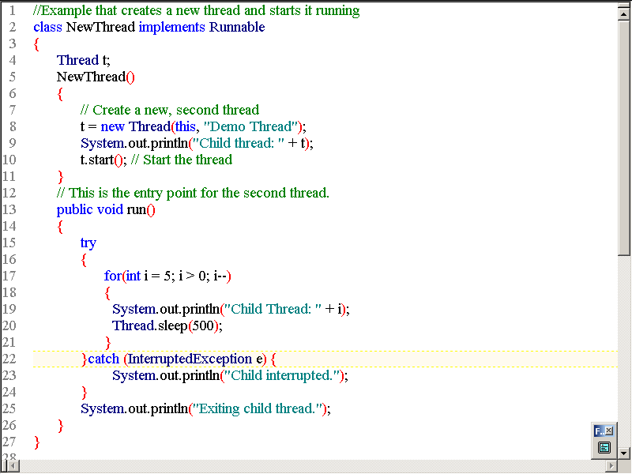

Slide 25
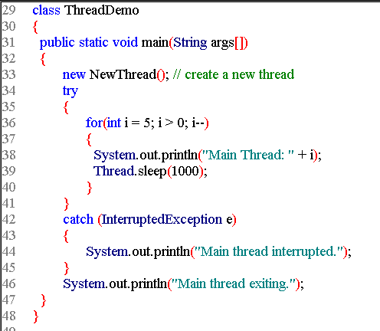

Slide 26
Output:
Child thread: Thread[Demo Thread,5,main]
Main Thread: 5
Child Thread: 5
Child Thread: 4
Main Thread: 4
Child Thread: 3
Child Thread: 2
Main Thread: 3
Child Thread: 1
Exiting child thread.
Main Thread: 2
Main Thread: 1
Main thread exiting.
Press any key to continue . . .

Slide 27
Extending Thread class
It includes the following steps :
  Declare the class as extending the Thread class.
  Implement the run() method that is responsible for executing the sequence of code that the thread will execute.
  Create a thread object and call the start() method to initiate the thread execution.

Slide 28
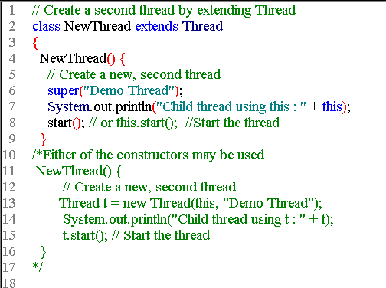

Slide 29
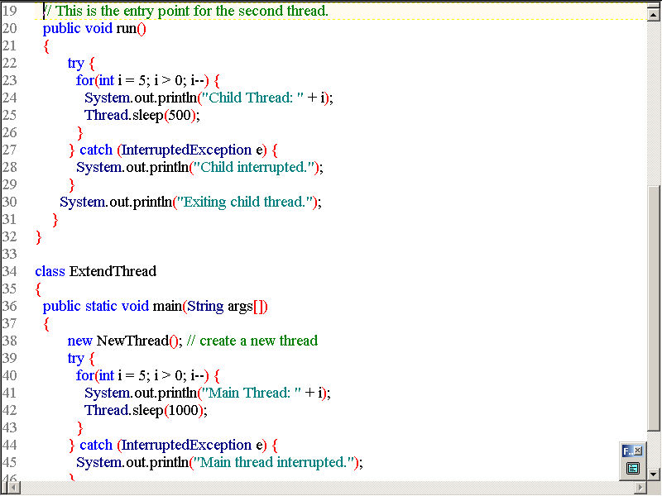

Slide 30
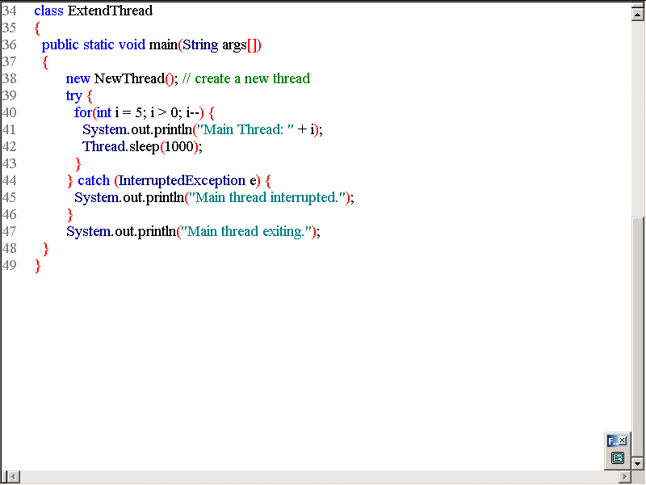

Slide 31
Output:
Child thread using this : Thread[Demo Thread,5,main]
Main Thread: 5
Child Thread: 5
Child Thread: 4
Main Thread: 4
Child Thread: 3
Child Thread: 2
Main Thread: 3
Child Thread: 1
Exiting child thread.
Main Thread: 2
Main Thread: 1
Main thread exiting.
Press any key to continue . . .

Slide 32
Choosing an Approach
When creating threads, implementing the Runnable interface is usually preferred because :
Extending the Thread class means that the subclass cannot extend any other class, whereas by implementing the Runnable interface, this option is open.
One must extend the Thread class approach if one wants to override other methods of the Thread class or wants to modify or enhance the class in some way.

Slide 33
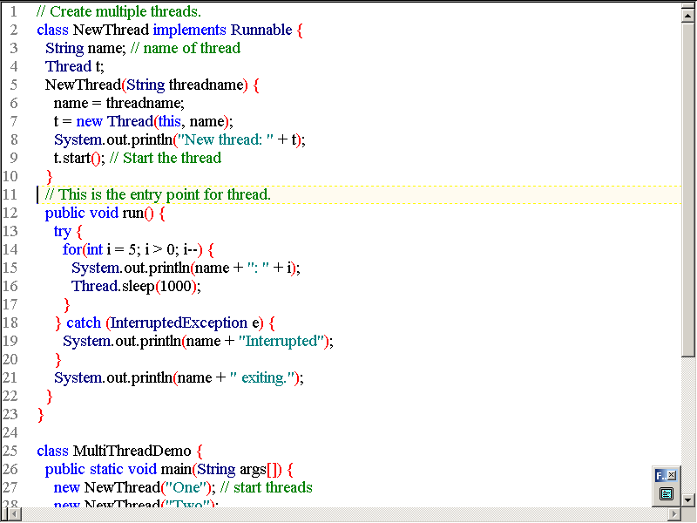

Slide 34
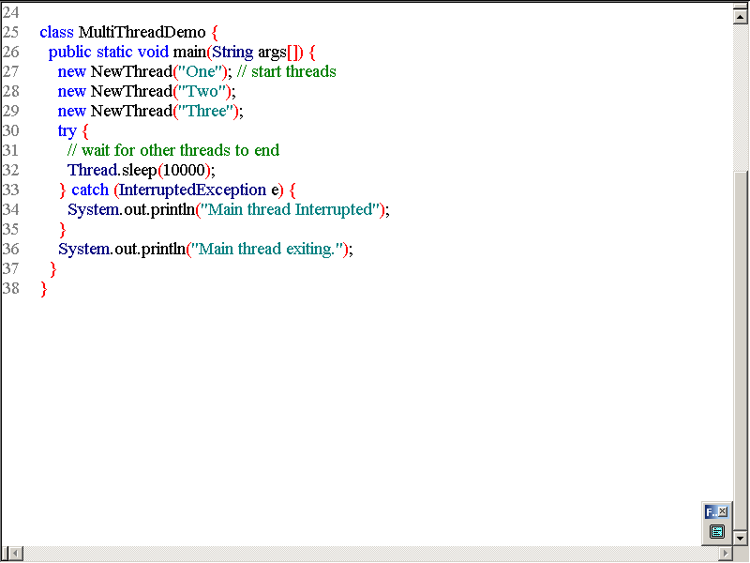

Slide 35
OUTPUT:
New thread: Thread[One,5,main]
New thread: Thread[Two,5,main]
New thread: Thread[Three,5,main]
One: 5
Two: 5
Three: 5
One: 4
Two: 4
Three: 4
One: 3
Two: 3
Three: 3
One: 2
Two: 2
Three: 2
One: 1
Two: 1
Three: 1
One exiting.
Two exiting.
Three exiting.
Main thread exiting.
Press any key to continue . . .

Slide 36
Scheduling and Priority
When a Thread object is first created, it is NEW. At this point, the thread is not executing. When you invoke the Thread's start() method, the thread changes to the RUNNABLE state.
RUNNABLE implies that the thread is alive and that it can be allocated CPU time by the system when the CPU is available.
Thread scheduling is the mechanism used to determine how RUNNABLE threads are allocated CPU time (that is, when they actually get to execute for a period of time on the computer's CPU).
A thread-scheduling mechanism is either preemptive or nonpreemptive.
With preemptive scheduling, the thread scheduler preempts (pauses) a running thread to allow different threads to execute.

Slide 37
A nonpreemptive scheduler never interrupts a running thread; instead, the nonpreemptive scheduler relies on the running thread to yield control of the CPU so that other threads may execute.
Under nonpreemptive scheduling, other threads may starve (never get CPU time) if the running thread fails to yield.
A preemptive scheduler can be either time-sliced or nontime-sliced.
With time-sliced scheduling, the scheduler allocates a period of time that each thread can use the CPU; when that amount of time has elapsed, the scheduler preempts the thread and switches to a different thread.
A nontime-sliced scheduler does not use elapsed time to determine when to preempt a thread; it uses other criteria such as priority or I/O status.

Slide 38
If a higher priority thread (higher than the current thread) becomes RUNNABLE, the scheduler preempts the current thread.
However, if an equal or lower priority thread becomes RUNNABLE, there is no guarantee that the new thread will ever be allocated CPU time until it becomes the highest priority RUNNABLE thread.

Slide 39
Setting Thread Priority
Every thread has a priority. When a thread is created, it inherits the priority of the thread that created it.
The priority can be adjusted subsequently using the setPriority() method. The priority of a thread may be obtained using getPriority().
There are three symbolic constants defined in the Thread class that represent the range of priority values: MIN_PRIORITY(1), NORM_PRIORITY(5), and MAX_PRIORITY(10).
An exception is thrown if you attempt to set priority values outside this range.

Slide 40
public final static int MAX_PRIORITY = 10;
public final static int MIN_PRIORITY = 1;
public final static int NORM_PRIORITY = 5;
public final int getPriority();
public final void setPriority(int newPriority);

Slide 41
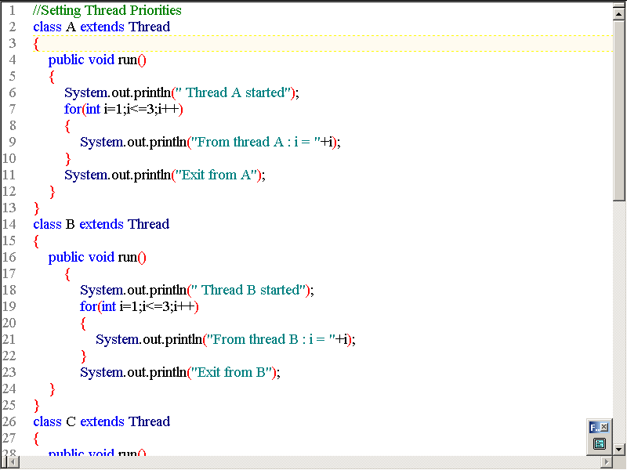

Slide 42
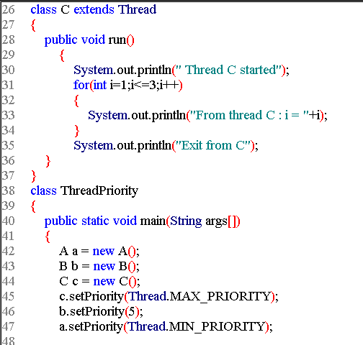

Slide 43
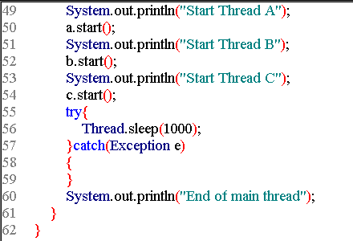

Slide 44
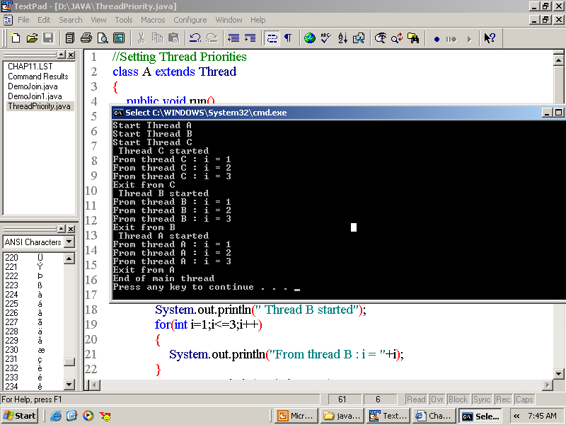

Slide 45
Stopping a Thread
A thread can be stopped from running further by calling its stop( ) method like :
aThread.stop( );
This causes the thread to move to the dead state.
stop( ) method may be used when the premature death of a thread is desired.

Slide 46
Blocking a Thread
A thread can be temporarily suspended or blocked from entering into the runnable(the state when the thread is ready for execution and is waiting for the availability of the processor) and subsequently running(the state when the processor has given its time to the thread for its execution) state by using either of the following thread methods :
  sleep( ) //blocked for a specified time
  suspend( ) //blocked until further orders
  wait( ) //blocked until certain condition occurs
The thread will return to the runnable state :
  When the specified time is elapsed in the case of sleep( )
  The resume( ) method is invoked in case of suspend( ) and,
  notify( ) method is called in case of wait( ).

Slide 50
ThreadGroup
The ThreadGroup class manages groups of threads for Java applications.
A ThreadGroup can contain any number of threads. The threads in a group are generally related in some way, such as who created them, what function they perform, or when they should be started and stopped.
ThreadGroups can contain not only threads but also other ThreadGroups.
The top thread group is named system; it contains several system-level threads (such as the garbage collector thread).
The system group also contains the main ThreadGroup object; the main group contains a main Thread-the thread in which main() is run.
You can create threads and thread groups in the main group.
You can also create threads and thread groups in subgroups of main.
The result is a root-like hierarchy of threads and thread groups.

Slide 51
Java thread groups are implemented by the ThreadGroup class in the java.lang package.
When a Java application first starts up, the Java runtime system creates a ThreadGroup named "main". So, unless specified otherwise, all new threads that you create become members of the "main" thread group.
To find out what group a thread is in, you can call its getThreadGroup() method.
theGroup = myThread.getThreadGroup();

Slide 52
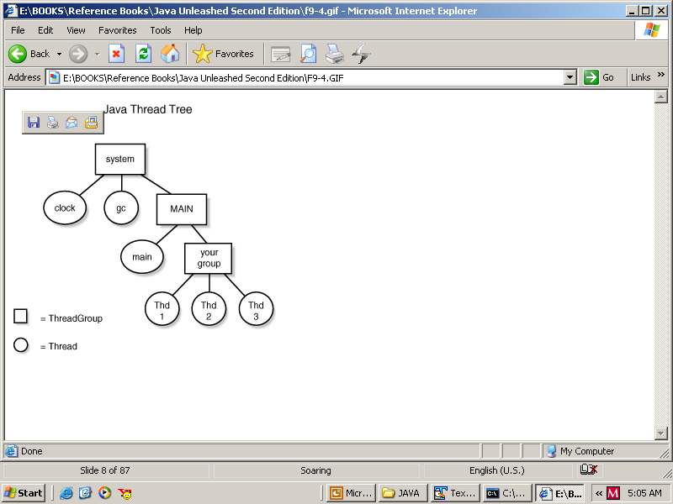
Graphical representation of the ThreadGroup tree:

Slide 53
CREATING A THREAD
A thread in java is represented by an object of the Thread class.
Implementing threads is achieved in one of the two ways :
  Implementing the java.lang.Runnable Interface.
  Extending the java.lang.Thread Class.

Slide 54
Implementing the Runnable Interface
The Runnable interface has the following general form :
public interface Runnable
{
public void run( );
}
the following steps are performed :
  Declare the class as implementing the Runnable interface.
  Implement the run( ) method which will be executed by the thread.
  An object of Thread class is created. An object of class implementing the Runnable interface is passed as an argument to a constructor of the Thread class.

Slide 55
  Contd..
  The start() method is invoked on the Thread object created in the previous step.
  Invocation of the start() method on the Thread object, which has been passed the object implementing the Runnable interface, will eventually result in the run() method being executed by the thread represented by the Thread object.

Slide 58
Output:
Child thread: Thread[Demo Thread,5,main]
Main Thread: 5
Child Thread: 5
Child Thread: 4
Main Thread: 4
Child Thread: 3
Child Thread: 2
Main Thread: 3
Child Thread: 1
Exiting child thread.
Main Thread: 2
Main Thread: 1
Main thread exiting.
Press any key to continue . . .

Slide 59
Extending Thread class
It includes the following steps :
  Declare the class as extending the Thread class.
  Implement the run() method that is responsible for executing the sequence of code that the thread will execute.
  Create a thread object and call the start() method to initiate the thread execution.

Slide 63
Output:
Child thread using this : Thread[Demo Thread,5,main]
Main Thread: 5
Child Thread: 5
Child Thread: 4
Main Thread: 4
Child Thread: 3
Child Thread: 2
Main Thread: 3
Child Thread: 1
Exiting child thread.
Main Thread: 2
Main Thread: 1
Main thread exiting.
Press any key to continue . . .

Slide 64
Choosing an Approach
When creating threads, implementing the Runnable interface is usually preferred because :
Extending the Thread class means that the subclass cannot extend any other class, whereas by implementing the Runnable interface, this option is open.
One must extend the Thread class approach if one wants to override other methods of the Thread class or wants to modify or enhance the class in some way.

Slide 67
OUTPUT:
New thread: Thread[One,5,main]
New thread: Thread[Two,5,main]
New thread: Thread[Three,5,main]
One: 5
Two: 5
Three: 5
One: 4
Two: 4
Three: 4
One: 3
Two: 3
Three: 3
One: 2
Two: 2
Three: 2
One: 1
Two: 1
Three: 1
One exiting.
Two exiting.
Three exiting.
Main thread exiting.
Press any key to continue . . .

Slide 68
Scheduling and Priority
When a Thread object is first created, it is NEW. At this point, the thread is not executing. When you invoke the Thread's start() method, the thread changes to the RUNNABLE state.
RUNNABLE implies that the thread is alive and that it can be allocated CPU time by the system when the CPU is available.
Thread scheduling is the mechanism used to determine how RUNNABLE threads are allocated CPU time (that is, when they actually get to execute for a period of time on the computer's CPU).
A thread-scheduling mechanism is either preemptive or nonpreemptive.
With preemptive scheduling, the thread scheduler preempts (pauses) a running thread to allow different threads to execute.

Slide 69
A nonpreemptive scheduler never interrupts a running thread; instead, the nonpreemptive scheduler relies on the running thread to yield control of the CPU so that other threads may execute.
Under nonpreemptive scheduling, other threads may starve (never get CPU time) if the running thread fails to yield.
A preemptive scheduler can be either time-sliced or nontime-sliced.
With time-sliced scheduling, the scheduler allocates a period of time that each thread can use the CPU; when that amount of time has elapsed, the scheduler preempts the thread and switches to a different thread.
A nontime-sliced scheduler does not use elapsed time to determine when to preempt a thread; it uses other criteria such as priority or I/O status.

Slide 70
If a higher priority thread (higher than the current thread) becomes RUNNABLE, the scheduler preempts the current thread.
However, if an equal or lower priority thread becomes RUNNABLE, there is no guarantee that the new thread will ever be allocated CPU time until it becomes the highest priority RUNNABLE thread.

Slide 71
Setting Thread Priority
Every thread has a priority. When a thread is created, it inherits the priority of the thread that created it.
The priority can be adjusted subsequently using the setPriority() method. The priority of a thread may be obtained using getPriority().
There are three symbolic constants defined in the Thread class that represent the range of priority values: MIN_PRIORITY(1), NORM_PRIORITY(5), and MAX_PRIORITY(10).
An exception is thrown if you attempt to set priority values outside this range.

Slide 72
public final static int MAX_PRIORITY = 10;
public final static int MIN_PRIORITY = 1;
public final static int NORM_PRIORITY = 5;
public final int getPriority();
public final void setPriority(int newPriority);

Slide 77
Stopping a Thread
A thread can be stopped from running further by calling its stop( ) method like :
aThread.stop( );
This causes the thread to move to the dead state.
stop( ) method may be used when the premature death of a thread is desired.

Slide 78
Blocking a Thread
A thread can be temporarily suspended or blocked from entering into the runnable(the state when the thread is ready for execution and is waiting for the availability of the processor) and subsequently running(the state when the processor has given its time to the thread for its execution) state by using either of the following thread methods :
  sleep( ) //blocked for a specified time
  suspend( ) //blocked until further orders
  wait( ) //blocked until certain condition occurs
The thread will return to the runnable state :
  When the specified time is elapsed in the case of sleep( )
  The resume( ) method is invoked in case of suspend( ) and,
  notify( ) method is called in case of wait( ).

Slide 79
LIFE CYCLE OF A THREAD
Life cycle of a thread consists of following states :
Newborn state
Runnable state
Running state
Blocked state
Dead state
A thread is always in one of these five states.
It can move from one state to another via a variety of ways as shown in figure.

Slide 80
State Transition Diagram of a thread
Newborn
New Thread
start
stop
Killed Thread
Active Thread
Running
Runnable
stop
Dead
yield
stop
(suspend, sleep, wait)
(resume, notify)
Idle Thread (Not Runnable)
Blocked

Slide 81
Newborn State
When we create a thread object, the thread is born and said to be in newborn state.
The thread is not yet scheduled for running.
At this state we can do only one of the following things with it :
  Schedule it for running using start( ) method.
  Kill it using stop( ) method.
If scheduled, it moves to the runnable state(as shown is fig.).
If we attempt to use any other method at this stage, an exception will be thrown.

Slide 82
Scheduling a newborn thread
Newborn
stop
start
Runnable
Dead

Slide 83
Runnable state
The runnable state means that the thread is ready for execution and is waiting for the availability of the processor.
That is, the thread has joined the queue of threads that are waiting for execution.
If all threads have equal priority, then they are given time slots for execution in round-robin fashion.
The thread that relinquishes control joins the queue at the end and again waits for its turn.
This process of assigning time to threads is known as time-slicing.
However, if we want a thread to relinquish control to another thread of equal priority before its turn comes, it can be done by using the yield( ) method.

Slide 84
Relinquishing control using yield( ) method
yield
Running Thread
Runnable Threads

Slide 85
Running state
Running state means that the processor has given its time to the thread for its execution.
The thread runs until it relinquishes control on its own or it is preempted by a higher priority thread.
A running thread may relinquish its control in one of the following situations :
  It has been suspended using suspend( ) method.
  A suspended thread can be revived by using the resume() method.
  This approach is useful when we want to suspend a thread for some time due to certain reason, but do not want to kill it.

Slide 86
Relinquishing control using suspend( ) method
suspend
resume
Running
Runnable
Suspended

Slide 87
Contd..
It has been made to sleep.
We can put a thread to sleep for a specified time period using the method sleep(time) where time is in milliseconds.
This means that the thread is out of the queue during this period.The thread reenters the runnable state as soon as this time period is elapsed.

Slide 88
Relinquishing control using sleep( ) method
Sleep(t)
after t
Running
Runnable
Sleeping

Slide 89
Contd..
It has been told to wait until some event occurs.
This is done using the wait( ) method.
The thread can be scheduled to run again using the notify( ) method.

Slide 90
Relinquishing control using wait( ) method
wait
notify
Running
Runnable
Waiting

Slide 91
Blocked State
A thread is said to be blocked when it is prevented from entering into the runnable state and subsequently the running state.
This happens when the thread is suspended, sleeping, or waiting in order to satisfy certain requirements.
A blocked thread is considered “not runnable” but not dead and therefore fully qualified to run again.

Slide 92
Dead State
A running thread ends its life when it has completed executing its run() method.
It is a natural death.
However, we can kill it by sending the stop message to it at any state thus causing a premature death to it.
A thread can be killed as soon as it is born, or while it is running, or even when it is in “not runnable” (blocked) condition.

Slide 93
SYNCHRONIZATION
When two or more threads need access to a shared resource, they need some way to ensure that the resource will be used by only one thread at a time.The process by which this is achieved is called synchronization.
Key to the synchronization is the concept of monitor(also called a semaphore).
A monitor is an object that is used as a mutually exclusive lock, or mutex.
Only one thread can own a monitor at a given time.

Slide 94
Contd..
When a thread acquires a lock, it is said to have entered the monitor.
All other threads attempting to enter the locked monitor will be suspended until the first thread exits the monitor.
These other threads are said to be waiting for the monitor.

Slide 95
Contd..
There are two ways by which synchronization in java is achieved:
Using synchronized methods: Here the method that has to be synchronized is preceded by the keyword synchronized.
Though using synchronized methods is good way of achieving synchronization, it does not work in all cases.
Imagine that you want to synchronize access to objects of a class that was not designed for multithreaded access. That is, the class does not use synchronized methods. Further, this class was not created by you, but by some third party, and you do not have access to the source code also. Thus, you cannot add synchronized to the appropriate methods within the class.
In such cases, the solution is : simply put calls to the methods defined by this class inside a synchronized block.

Slide 96
Contd..
Using synchronized block: the general form of the synchronized statement is :
    synchronized (object)
    {
    // statements to be synchronized
    }
Here, object is a reference to the object being synchronized.

Slide 97
Daemon Threads
Any Java thread can be a daemon thread.
Daemon means, A background process that handles requests for services such as print spooling and file transfers, and is dormant when not required.
Daemon threads are service providers for other threads running in the same process as the daemon thread. For example, the HotJava browser uses up to four daemon threads named "Image Fetcher" to fetch images from the file system or network for any thread that needs one.
The run() method for a daemon thread is typically an infinite loop that waits for a service request.
When the only remaining threads in a process are daemon threads, the interpreter exits. This makes sense because when only daemon threads remain, there is no other thread for which a daemon thread can provide a service.
To specify that a thread is a daemon thread, call the setDaemon() method with the argument true.
To determine if a thread is a daemon thread, use the accessor method isDaemon().

